Slide 1
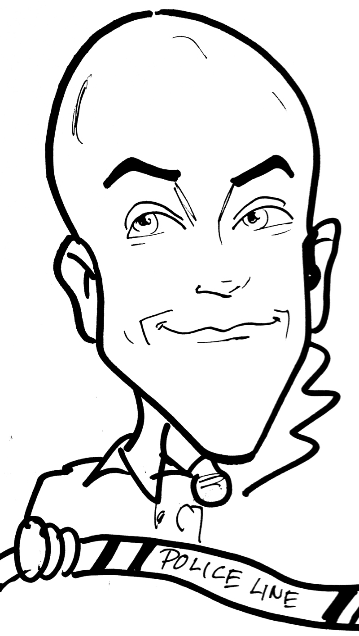

A.L.i.C.E
ENHANCED LOCKDOWN
‘RESPONSE OPTIONS’
Why do we need options?
What are the Liabilities?
Student Presentation
2013
SRO Gongwer

Slide 2
  Officer Adam Gongwer
    13th year with Ontario Police
    8th year as SRO (School Resource Officer)
    HNT Member (2006)
    D.A.R.E. Class #61 (2009)
    A.L.i.C.E. instructor (Lockdown enhancements)
    Secretary/Treasurer for Board of Directors ‘15-’17
        Ohio SRO Assoc. (OSROA.org)
    Previous Experience:
    JV Corrections Officer
    Youth Minister
    Family:
    4 Kids (8, 16, 16, 19)
    Married 24 years

Slide 3
Recent Trends Nationwide:
Since 2012

Slide 4

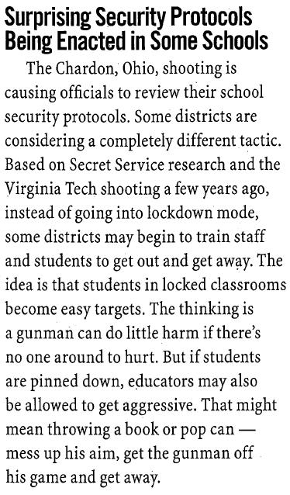
March 2012

Slide 5
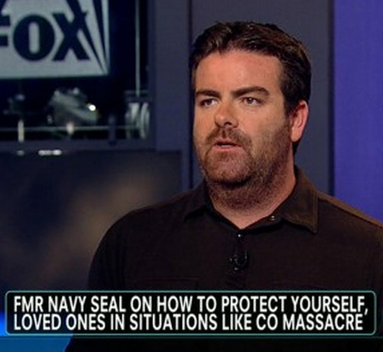
July 2012
“In these active shooter situations, if you look historically, most of these shooters, they are not
well-experienced marksmen.
So for one, hitting a moving target is very hard […] I think people don’t realize you can get up and run and take action.
Get up and out of that
movie theater.”
“You have to think self-rescue in these situations. Closing your eyes and hoping that it’s going to go away is just not the case.”
foxnewsinsider.com (7/24/12)
Brandon Webb, a former Navy SEAL, joined America Live (FOX News) to give his tips for how you can protect yourself should you find yourself in a situation similar to the Colorado shooting.

Slide 6
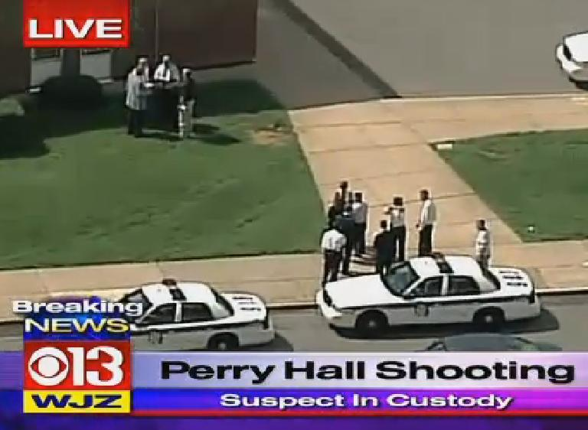
August 27, 2012, Maryland
Student shot on
first day of school
…. at about 10:45 a.m., a student walked into the cafeteria and pulled out a gun. He fired one shot before being grabbed by teachers, and then another shot went off as teachers grabbed him, Johnson said.
"We have some heroic and brave faculty members," Schools Superintendent Dallas Dance said. "They responded very quickly to minimize damage."
The school was evacuated, and students were escorted to a nearby shopping center and middle school.

Slide 7
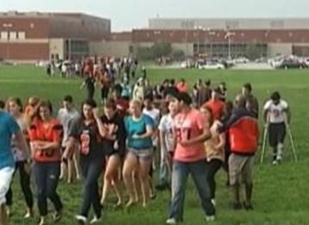
September 7, 2012
NORMAL, IL.
….. teacher seized the opportunity to tackle the shooter while he set his gun down.
Police say a 14-year-old student is in custody.
…. the gunman pulled a handgun and hatchet from a backpack and told students in the room that no one wanted to listen to him talk about unspecified problems.
Kennedy says the gun was fired after some students snuck out.
He says the gunman then set the gun down and the teacher tackled him.
(Copyright ©2012 by
The Associated Press.
All Rights Reserved.)

Slide 8
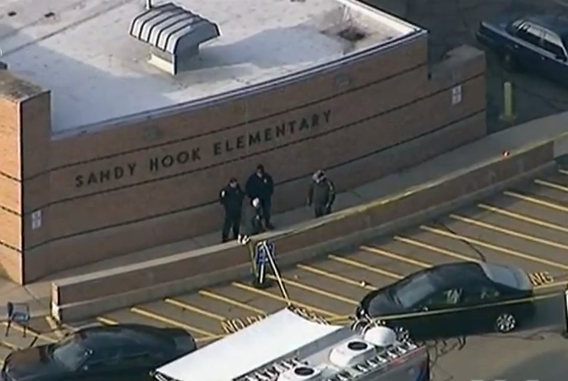
December 14, 2012
Sandy Hook Elementary,
Newtown, Connecticut
First grade teacher Kaitlin Roig, hid 14 students in a bathroom and barricaded the door, telling them to be completely quiet to remain safe.
School library staff Yvonne Cech and Maryann Jacob first hid 18 children in a part of the library the school used for lockdown in practice drills, but on discovering that one of the doors would not lock, had the children crawl into a storage room as Yvonne barricaded the door with a filing cabinet.

Slide 9

April 9, 2013
Lone Star College Cy-Fair campus,
Houston, TX
Stabbing injures several on Lone Star College Cy-Fair campus.
When tackled, the suspect reportedly said, 'I give up, I give up.'
"One kid grabbed him by the backpack, the other grabbed him by the arm, and the kid just said he gave up, and we just sat on him until the cops came," Maida said.
Various internet sources

Slide 10
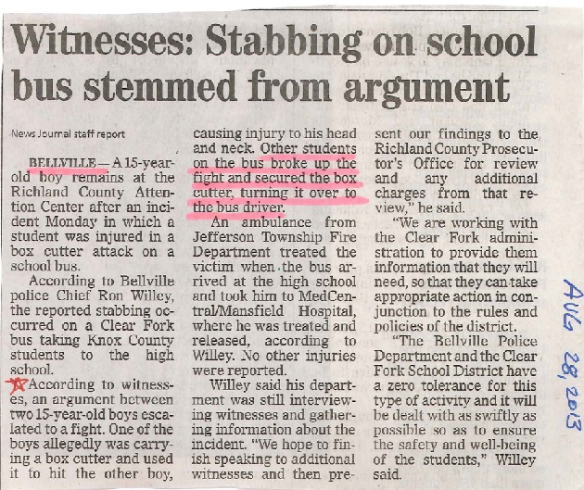

Slide 11
Oct 25, 2014
Marysville-Pilchuck High School,
Marysville (near Seattle), WA
Jaylen Fryberg, freshman, was well liked and athletic, a football player named to his high school's homecoming court just one week ago.
He was also facing problems, writing of some unspecified troubles on his Twitter feed: “It breaks me... It actually does....”
Students said the gunman stared at his victims as he fired. The shootings set off a chaotic scene as students ran from the cafeteria and building in a frantic dash to safety, while others huddled inside classrooms at the school.
http://www.policeone.com/school-violence/articles/7733124-Wash-school-gunman-was-well-liked-homecoming-prince/

Slide 12
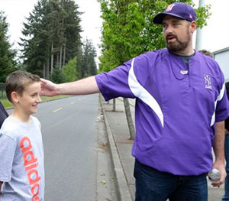
April 29, 2015
North Thurston High School,
Lacey (near Seattle), WA
In the moments after a 16-year-old boy fired two gunshots in a Washington state high school and walked toward a commons area where students were gathering before class — a couple of things went right.
A teacher raced toward the boy, grabbing him and taking him to the ground to keep him from firing again.
Brady Olson's quick action may also have spared the student's life, since a school police officer says he was just a step away from having a clear shot at the teen.
http://www.policeone.com/school-violence/articles/8536461-Wash-teachers-quick-action-may-have-saved-armed-teen/

Slide 13
Why have we been thinking we should only hide?
93% of school shooters planned the attack in advance. (National Center for the Analysis of Violent Crime)
95% of school shooters were attending or had attended the facility where the shooting occurred. (Secret Service Study)
74% of all Active Shooters have some relationship to their victims. (The NYPD report on Active Shooter)

Slide 14
Preparing Our Faculty and Students
Traditional response is the defensive strategy of Securing-in-Place, called LOCKDOWN.
Copyright 2007 © Response Options

Slide 15
Preparing Our Faculty and Students
Traditional response is the defensive strategy of Securing-in-Place, called LOCKDOWN.
One tool in the toolbox – best practice?
Copyright 2007 © Response Options
Notes:
15

Slide 16
Preparing Our Faculty and Students
Traditional response is the defensive strategy of Securing-in-Place, called LOCKDOWN.
One tool in the toolbox – best practice?
Goal: to equip staff and students with more options that work in “real” situations.
Copyright 2007 © Response Options
Notes:
16

Slide 17
ACTIVE
SHOOTER
MYTHS:
Copyright 2007 © Response Options

Slide 18
Myth #1: They always display tendencies for violent acts
Copyright 2007 © Response Options
Notes:
18

Slide 19
Myth #1: They always display tendencies for violent acts
While many do show signs, in most cases those signs are not recognized until after the deed.
Copyright 2007 © Response Options

Slide 20
Myth #1: They always display tendencies for violent acts
While many do show signs, in most cases those signs are not recognized until after the deed.
Too late
Copyright 2007 © Response Options
Notes:
20

Slide 21
Myth #2: It will not happen here
Copyright 2007 © Response Options
Notes:
21

Slide 22
Myth #2: It will not happen here
Anywhere, Anytime, Any Reason
Copyright 2007 © Response Options

Slide 23
Myth #2: It will not happen here
Anywhere, Anytime, Any Reason
Amish School ?? October 2, 2006: 5 Dead, 5 Injured
Copyright 2007 © Response Options
Notes:
23

Slide 24
Myth #2: It will not happen here
Anywhere, Anytime, Any Reason
Amish School ?? October 2, 2006: 5 Dead, 5 Injured
Security Measures, Infrastructure Precautions, Procedural Response:
will deter most, but not all.
Copyright 2007 © Response Options
Notes:
24

Slide 25
Myth #3: Police will respond in time to prevent carnage
Copyright 2007 © Response Options
Notes:
25

Slide 26
Myth #3: Police will respond in time to prevent carnage
Columbine Library – 7.5 minutes
  SRO on campus
Copyright 2007 © Response Options

Slide 27
Myth #3: Police will respond in time to prevent carnage
Columbine Library – 7.5 minutes
  SRO on campus
Norris Hall, VA Tech – 8 minutes
  Double Homicide being investigated 800 yards away
Copyright 2007 © Response Options
Notes:
27

Slide 28
Myth #3: Police will respond in time to prevent carnage
Columbine Library – 7.5 minutes
  SRO on campus
Norris Hall, VA Tech – 8 minutes
  Double Homicide being investigated 800 yards away
Success Tech High – 2 minutes
  Downtown Cleveland, FBI office directly across the street
Copyright 2007 © Response Options
Notes:
28

Slide 29
Myth #4: Faculty and Students can do nothing against an armed intruder
Copyright 2007 © Response Options
Notes:
29

Slide 30
Myth #4: Faculty and Students can do nothing against an armed intruder
A large number will flee, following natural response. (Fight or Flight)
Copyright 2007 © Response Options

Slide 31
Myth #4: Faculty and Students can do nothing against an armed intruder
A large number will flee, following natural response. (Fight or Flight)
Further numbers will also be able to escape if properly informed.
Copyright 2007 © Response Options
Notes:
31

Slide 32
Myth #4: Faculty and Students can do nothing against an armed intruder
Shooting is a physical skill
Copyright 2007 © Response Options

Slide 33
Myth #4: Faculty and Students can do nothing against an armed intruder
Shooting is a physical skill
Degree of accuracy and level of skill required is directly dependent on the actions of the target:
Copyright 2007 © Response Options
Notes:
33

Slide 34
Myth #4: Faculty and Students can do nothing against an armed intruder
Shooting is a physical skill
Degree of accuracy and level of skill required is directly dependent on the actions of the target:
  Distance
Copyright 2007 © Response Options
Notes:
34

Slide 35
Myth #4: Faculty and Students can do nothing against an armed intruder
Shooting is a physical skill
Degree of accuracy and level of skill required is directly dependent on the actions of the target:
  Distance
  Movement
Copyright 2007 © Response Options
Notes:
35

Slide 36
Myth #4: Faculty and Students can do nothing against an armed intruder
Shooting is a physical skill
Degree of accuracy and level of skill required is directly dependent on the actions of the target:
  Distance
  Movement
  Distractions
Copyright 2007 © Response Options
Notes:
36

Slide 37
Myth #4: Faculty and Students can do nothing against an armed intruder
Police miss almost 80% of their shots in dynamic events.
Copyright 2007 © Response Options

Slide 38
Myth #4: Faculty and Students can do nothing against an armed intruder
Police miss almost 80% of their shots in dynamic events.
We need to recreate that environment in the classroom when someone comes in with intent to kill our kids.
Copyright 2007 © Response Options
Notes:
38

Slide 39
How Faculty and Students Survive
When our security and deterrence measures fail, then we must …
Instruct faculty and students in very simple strategies that facilitate:
Copyright 2007 © Response Options
Notes:
39

Slide 40
How Faculty and Students Survive
When our security and deterrence measures fail, then we must …
Instruct faculty and students in very simple strategies that facilitate:
  Intelligent Escape
Copyright 2007 © Response Options

Slide 41
How Faculty and Students Survive
When our security and deterrence measures fail, then we must …
Instruct faculty and students in very simple strategies that facilitate:
  Intelligent Escape
  Force High Level of Skill to Shoot Accurately
Copyright 2007 © Response Options
Notes:
41

Slide 42
How Faculty and Students Survive
When our security and deterrence measures fail, then we must …
Instruct faculty and students in very simple strategies that facilitate:
  Intelligent Escape
  Force High Level of Skill to Shoot Accurately
  Utilize Unknown Advantages to Win Back Control
Copyright 2007 © Response Options
Notes:
42

Slide 43
A.L.i.C.E
Alert: Complete information

Slide 44
A.L.i.C.E
Alert: Complete information
N.I.M.S. says:
“Normal language” no codes
Notes:
44

Slide 45
A.L.i.C.E
Alert: Complete information
Lockdown: Initial Barrier
Notes:
45

Slide 46
A.L.i.C.E
Alert: Complete information
Lockdown: Initial Barrier
Teach how to Barricade:
Belts on door knobs
Desks blocking doorway
Notes:
46

Slide 47
A.L.i.C.E
Alert: Complete information
Lockdown: Initial Barrier
Inform: Real-time Updates
Notes:
47

Slide 48
A.L.i.C.E
Alert: Complete information
Lockdown: Initial Barrier
Inform: Real-time Updates
Continue info, confuse & frustrate attacker, redirect his/her focus
Notes:
48

Slide 49
A.L.i.C.E
Alert: Complete information
Lockdown: Initial Barrier
Inform: Real-time Updates
Counter: Require High Skill Level
Notes:
49

Slide 50
A.L.i.C.E
Alert: Complete information
Lockdown: Initial Barrier
Inform: Real-time Updates
Counter: Require High Skill Level
Interrupt the physical/mental act of..
Notes:
50

Slide 51
A.L.i.C.E
Alert: Complete information
Lockdown: Initial Barrier
Inform: Real-time Updates
Counter: Require High Skill Level
Evacuate: Get Out!
Notes:
51

Slide 52
A.L.i.C.E
Alert: Complete information
Lockdown: Initial Barrier
Inform: Real-time Updates
Counter: Require High Skill Level
Evacuate: Get Out!
If safe…planned, practiced…
Notes:
52

Slide 53
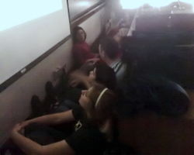
Students take cover in French Class in Holden Hall, Virginia Tech. Next door to carnage at Norris Hall.
Photo by Chase Damiano
Do these students look ready and prepared to escape, evade, or counter an Active Shooter?
We can prepare our community for this very rare, but very real, possibility.
Copyright 2007 © Response Options
Notes:
53

Slide 54
THE Lesson from VT:
2 vs. 28
Proactive vs. Passive
1
Room 206 - 14 Present
Killed – 10
Wounded -2
Room 204 –
Room 210
No Class
Room 200
No Class
Hallway
Offices
Room 211 –
Room 207 –
Room 205 –

Slide 55
THE Lesson from VT:
2 vs. 28
Proactive vs. Passive
Room 206 - 14 Present
Killed – 10
Wounded -2
Room 204 –
Room 210
No Class
Room 200
No Class
Hallway
2
Offices
Room 211 –
Calls 911
1 minute later
Room 207 –
Room 205 –

Slide 56
THE Lesson from VT:
2 vs. 28
Proactive vs. Passive
Room 206 - 14 Present
Killed – 10
Wounded -2
Room 204 –
Room 210
No Class
Room 200
No Class
Hallway
3
Offices
Room 211 –
Room 207 – 13 Present
Killed – 5
Wounded - 6
Room 205 –

Slide 57
THE Lesson from VT:
2 vs. 28
Proactive vs. Passive
Room 206 - 14 Present
Killed – 10
Wounded -2
Room 204 –
Room 210
No Class
Room 200
No Class
Hallway
4
Offices
Room 211 – 19 Present
Killed – 12
Wounded - 6
Room 207 – 13 Present
Killed – 5
Wounded - 6
Room 205 –
Room 211 tried to barricade the door……

Slide 58
THE Lesson from VT:
2 vs. 28
Proactive vs. Passive
Room 206 - 14 Present
Killed – 10
Wounded -2
Room 204 –
Room 210
No Class
Room 200
No Class
Hallway
5
Offices
Room 211 – 19 Present
Killed – 12
Wounded - 6
Room 207 – 13 Present
Killed – 5
Wounded - 6
Room 205 –
12 Present
Killed – 0
Wounded – 0
Room 205 Barricaded!

Slide 59
THE Lesson from VT:
2 vs. 28
Proactive vs. Passive
Room 206 - 14 Present
Killed – 10
Wounded -2
Room 204 –
Room 210
No Class
Room 200
No Class
Hallway
6
Offices
Room 211 – 19 Present
Killed – 12
Wounded - 6
Room 207 – 13 Present
Killed – 5
Wounded - 6
Room 205 –
12 Present
Killed – 0
Wounded – 0
Room 207 Now Barricaded!

Slide 60
THE Lesson from VT:
2 vs. 28
Proactive vs. Passive
Room 206 - 14 Present
Killed – 10
Wounded -2
Room 204 –
Room 210
No Class
Room 200
No Class
Hallway – Killed 1
7
Offices
Room 211 – 19 Present
Killed – 12
Wounded - 6
Room 207 – 13 Present
Killed – 5
Wounded - 6
Room 205 –
12 Present
Killed – 0
Wounded – 0
Room 211 again

Slide 61
THE Lesson from VT:
2 vs. 28
Proactive vs. Passive
8
Room 206 - 14 Present
Killed – 10
Wounded -2
Room 204 – 19 Present
Killed – 2
Wounded - 3
Room 210
No Class
Room 200
No Class
Hallway – Killed 1
Offices
Room 211 – 19 Present
Killed – 12
Wounded - 6
Room 207 – 13 Present
Killed – 5
Wounded - 6
Room 205 –
12 Present
Killed – 0
Wounded – 0
Professor shot through the barricaded door…..room evacuated

Slide 62

Hupp told students one reason shooters go to schools is because they expect minimal resistance. He referred to reports that Seung-Hui Cho, who shot and killed 32 people on the campus of Virginia Tech, practiced for his killing spree by running along and firing at targets on the ground, intended to represent students lying prone.
….training to teach others about the A.L.I.C.E. program, Marietta Police Sgt. Rod Hupp
April 16, 2007
28 dead (passive)
2 dead (active)
25 wounded
deadliest shooting incident by a single gunman in U.S. history

Slide 63
Kip Kinkle, suspended. Killed his parents the night before, went to school the next day…..
When Kinkel's rifle ran out of ammunition and he began to reload, wounded student Jacob Ryker tackled him, assisted by several other students. Kinkel drew the Glock and fired one shot before he was disarmed, injuring Ryker again as well as another student. The students restrained Kinkel until the police arrived and arrested him. A total of seven students were involved in subduing and disarming Kinkel.
Thurston
High School
Springfield, Oregon
May 21, 1998
2 dead
24 wounded

Slide 64
FAQ’s concerning the ALiCE program:
If my child gets proactive, couldn’t they get hurt?
  Yes, they could. But being passive and static has not shown to be an effective response in most Active Shooter events. The differences of tragic outcomes in the classrooms at VT are a good example explaining the difference of passive and active in determining survival chances.

Slide 65
FAQ’s concerning the ALiCE program:
Why change what has always worked?
  Has “Lockdown” really worked, or have just the practice drills always worked? We know the names of many schools around the world precisely because “Lockdown” did not meet their needs during the violence, and tragedy ensued.
  Columbine, CO 1999
  Beslan (Russia) 2004
  Chardon, OH 2012

Slide 66
FAQ’s concerning the ALiCE program:
Isn’t this what the police are for?
  Obviously the police cannot be at all places, all of the time. Hundreds of rounds can be expended in just mere minutes.

Slide 67
FAQ’s concerning the ALiCE program:
  Could we be training our future “enemy”?
  Yes, we could. But there could very well be a deterrent effect caused due to this training if the future attacker knows their goals of a body-count will be very limited at this institution.

Slide 68
FAQ’s concerning the ALiCE program:
  Isn’t there a possibility of secondary attacks if
  people are trying to leave the area?
    There is always a possibility of a secondary attack, no matter what the event. But our fear of the unknown should not interfere with our manner of dealing with the known. Common sense says a shooter inside the building should dictate getting out, much more than the fear of perhaps another shooter outside should dictate staying inside with the known shooter. Any shooters outside will be contacted and neutralized by police much quicker than one inside the building.

Slide 69
FAQ’s concerning the ALiCE program:
  Do we want the bad guy to know
  ‘that we know’ where he is?
    What could we tell him that he doesn’t already know?

Slide 70
FAQ’s concerning the ALiCE program:
  Won’t proactive actions agitate the gunman
  to commit violence?
    It is accepted that these people seek one thing – as big a body count as they can achieve in the time afforded to them.
    How can a determined killer be made more violent?

Slide 71
Some of the 50+ Ohio Schools and Colleges
using the ALiCE program:
Akron High Schools, Middle Schools & University
  Ashland City Schools
  Bowling Green State University
  Findlay School District
  Gahanna Schools
  Kent State University
  Miami University
  Ohio University
  Perry Township Schools
  Perrysburg Township Schools
  Shawnee School District
  Shelby Schools
  Springfield Schools
  University of Cincinnati
  Wright State University

Slide 72
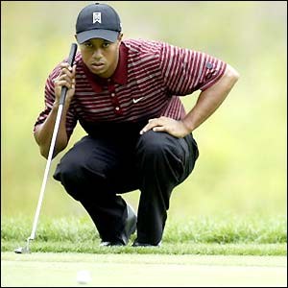
Let’s Get Started
Mental Preparation is the most important thing that will decide if you will survive a violent encounter. The ability to quickly make decisions while under extreme duress, stress, and fear separates survivors from statistics. So while violent attacks on schools are statistically very rare, the fact that they do occur, and occur on such a random basis, requires that every one of us who has the charge of responsibility to look out for the safety of kids prepare for the worst.

Slide 73
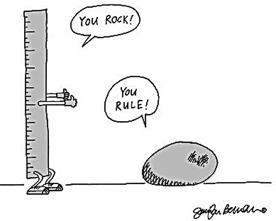
Rules to Live By:

Slide 74
Rules to Live By:
• You have the right / duty to survive any critical incident

Slide 75
Rules to Live By:
• You have the right / duty to survive any critical incident
• Prior preparation & planning prevents poor performance

Slide 76
Rules to Live By:
• You have the right / duty to survive any critical incident
• Prior preparation & planning prevents poor performance
• Be proactive; DO SOMETHING (ABN: Anything beats Nothing)

Slide 77
Rules to Live By:
• You have the right / duty to survive any critical incident
• Prior preparation & planning prevents poor performance
• Be proactive; DO SOMETHING (ABN: Anything beats Nothing)
• There are “Shepherds” & “Sheep” - & there are “Wolves”

Slide 78
Rules to Live By:
• You have the right / duty to survive any critical incident
• Prior preparation & planning prevents poor performance
• Be proactive; DO SOMETHING (ABN: Anything beats Nothing)
• There are “Shepherds” & “Sheep” - & there are “Wolves”
• Interrupt the bad guy’s plan

Slide 79
Rules to Live By:
• You have the right / duty to survive any critical incident
• Prior preparation & planning prevents poor performance
• Be proactive; DO SOMETHING (ABN: Anything beats Nothing)
• There are “Shepherds” & “Sheep” - & there are “Wolves”
• Interrupt the bad guy’s plan
• Instead of “What-If?”, think “When - then”

Slide 80
Rules to Live By:
• You have the right / duty to survive any critical incident
• Prior preparation & planning prevents poor performance
• Be proactive; DO SOMETHING (ABN: Anything beats Nothing)
• There are “Shepherds” & “Sheep” - & there are “Wolves”
• Interrupt the bad guy’s plan
• Instead of “What-If?”, think “When - then”
• Break the chain of consequences as early as you can

Slide 81
Rules to Live By:
• You have the right / duty to survive any critical incident
• Prior preparation & planning prevents poor performance
• Be proactive; DO SOMETHING (ABN: Anything beats Nothing)
• There are “Shepherds” & “Sheep” - & there are “Wolves”
• Interrupt the bad guy’s plan
• Instead of “What-If?”, think “When - then”
• Break the chain of consequences as early as you can
• You don’t have to be a superhero

Slide 82
Rules to Live By:
• You have the right / duty to survive any critical incident
• Prior preparation & planning prevents poor performance
• Be proactive; DO SOMETHING (ABN: Anything beats Nothing)
• There are “Shepherds” & “Sheep” - & there are “Wolves”
• Interrupt the bad guy’s plan
• Instead of “What-If?”, think “When - then”
• Break the chain of consequences as early as you can
• You don’t have to be a superhero
• Do what you can, as long as you must

Slide 83
“ALICE” is an acronym for 5 steps you can utilize in order to increase your chances of surviving a surprise attack by an Active Shooter.
It is important to remember that the “ALICE” response does not follow a set of actions you “shall, must, will” do when confronted with an Active Shooter.
Your survival is paramount in this situation. Deal with known information and don’t worry about unknowns.
You may use only 1 or 2 parts of the response plan or you may have to utilize all 5. In this type of incident, your perception is the reality and you will be deciding what the appropriate action for you to take is.

Slide 84

Alert- Can be anything.

Slide 85
Alert- Can be anything.
Gunfire

Slide 86
Alert- Can be anything.
Gunfire
Witness

Slide 87
Alert- Can be anything.
Gunfire
Witness
PA Announcement (be Specific)

Slide 88
Alert- Can be anything.
Gunfire
Witness
PA Announcement
Phone alert

Slide 89

LOCKDOWN: This is a semi-secure starting point from which to make survival decisions.
*If you decide to not evacuate, secure the room.

Slide 90
LOCKDOWN: This is a semi-secure starting point from which to make survival decisions.
*If you decide to not evacuate, secure the room.
Lock the door. (Call 911?)

Slide 91
LOCKDOWN: This is a semi-secure starting point from which to make survival decisions.
*If you decide to not evacuate, secure the room.
Lock the door. (Call 911?)
Cover any windows in the door if possible

Slide 92
LOCKDOWN: This is a semi-secure starting point from which to make survival decisions.
*If you decide to not evacuate, secure the room.
Lock the door. (Call 911?)
Cover any windows in the door if possible
Tie down the door, if possible: using belts, purse straps, shoe laces, etc.

Slide 93
LOCKDOWN: This is a semi-secure starting point from which to make survival decisions.
*If you decide to not evacuate, secure the room.
Lock the door. (Call 911?)
Cover any windows in the door if possible
Tie down the door, if possible: using belts, purse straps, shoe laces, etc.
Barricade the door with anything (desks, chairs, etc.)

Slide 94
LOCKDOWN: This is a semi-secure starting point from which to make survival decisions.
*If you decide to not evacuate, secure the room.
Lock the door. (Call 911?)
Cover any windows in the door if possible
Tie down the door, if possible: using belts, purse straps, shoe laces, etc.
Barricade the door with anything (desks, chairs, etc.)
Look for alternate escape routes (windows, other doors)

Slide 95
LOCKDOWN: This is a semi-secure starting point from which to make survival decisions.
*If you decide to not evacuate, secure the room.
Lock the door. (Call 911?)
Cover any windows in the door if possible
Tie down the door, if possible: using belts, purse straps, shoe laces, etc.
Barricade the door with anything (desks, chairs, etc.)
Look for alternate escape routes (windows, other doors)
Move out of the doorway in case gunfire comes through it

Slide 96
LOCKDOWN: This is a semi-secure starting point from which to make survival decisions.
*If you decide to not evacuate, secure the room.
Lock the door. (Call 911?)
Cover any windows in the door if possible
Tie down the door, if possible: using belts, purse straps, shoe laces, etc.
Barricade the door with anything (desks, chairs, etc.)
Look for alternate escape routes (windows, other doors)
Move out of the doorway in case gunfire comes through it
Silence or place cell phones on vibrate

Slide 97
LOCKDOWN: This is a semi-secure starting point from which to make survival decisions.
*If you decide to not evacuate, secure the room.
Lock the door. (Call 911?)
Cover any windows in the door if possible
Tie down the door, if possible: using belts, purse straps, shoe laces, etc.
Barricade the door with anything (desks, chairs, etc.)
Look for alternate escape routes (windows, other doors)
Move out of the doorway in case gunfire comes through it
Silence or place cell phones on vibrate
Once secured, do not open the door for anyone. Police will enter the room when the situation is over.

Slide 98
LOCKDOWN: This is a semi-secure starting point from which to make survival decisions.
*If you decide to not evacuate, secure the room.
Lock the door. (Call 911?)
Cover any windows in the door if possible
Tie down the door, if possible: using belts, purse straps, shoe laces, etc.
Barricade the door with anything (desks, chairs, etc.)
Look for alternate escape routes (windows, other doors)
Move out of the doorway in case gunfire comes through it
Silence or place cell phones on vibrate
Once secured, do not open the door for anyone. Police will enter the room when the situation is over.
Gather weapons (coffee cups, chairs, books, pens, etc.) and mentally prepare to defend yourself or others.

Slide 99
LOCKDOWN: This is a semi-secure starting point from which to make survival decisions.
*If you decide to not evacuate, secure the room.
Lock the door. (Call 911?)
Cover any windows in the door if possible
Tie down the door, if possible: using belts, purse straps, shoe laces, etc.
Barricade the door with anything (desks, chairs, etc.)
Look for alternate escape routes (windows, other doors)
Move out of the doorway in case gunfire comes through it
Silence or place cell phones on vibrate
Once secured, do not open the door for anyone. Police will enter the room when the situation is over.
Gather weapons (coffee cups, chairs, books, pens, etc.) and mentally prepare to defend yourself or others.
Put yourself in position to surprise the active shooter should they enter the room.

Slide 100

Inform- Using any means necessary to pass on real time information.

Slide 101
Inform- Using any means necessary to pass on real time information.
Given in plain language.

Slide 102
Inform- Using any means necessary to pass on real time information.
Given in plain language.
Can be derived from 911 calls, video surveillance, etc.

Slide 103
Inform- Using any means necessary to pass on real time information.
Given in plain language.
Can be derived from 911 calls, video surveillance, etc.
Who, what, where, when and how information

Slide 104
Inform- Using any means necessary to pass on real time information.
Given in plain language.
Can be derived from 911 calls, video surveillance, etc.
Who, what, where, when and how information
Can be used by people in the area or who may come into it to make common sense decisions

Slide 105
Inform- Using any means necessary to pass on real time information.
Given in plain language.
Can be derived from 911 calls, video surveillance, etc.
Who, what, where, when and how information
Can be used by people in the area or who may come into it to make common sense decisions
Can be given by “Flash Alerts”, PA Announcements or Police Radio speakers

Slide 106
Inform- Using any means necessary to pass on real time information.
Given in plain language.
Can be derived from 911 calls, video surveillance, etc.
Who, what, where, when and how information
Can be used by people in the area or who may come into it to make common sense decisions
Can be given by “Flash Alerts”, PA Announcements or Police Radio speakers
Confuse/Frustrate Attacker

Slide 107
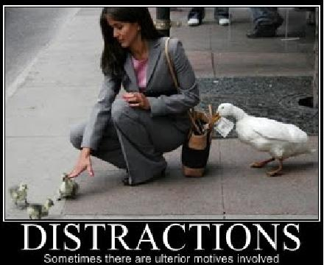
Counter- This is the use of simple, proactive techniques should you be confronted by the Active Shooter.
DISTRACT ATTACKER

Slide 108
Why Distract? In order to shoot accurately, a person must be able to complete a physical process:

Slide 109
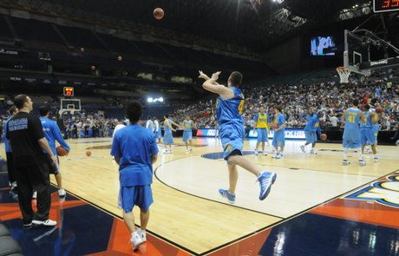
Why Distract? In order to shoot accurately, a person must be able to complete a physical process:
1. Find the target: Distance between shooter and target requires greater skill to hurt you.

Slide 110
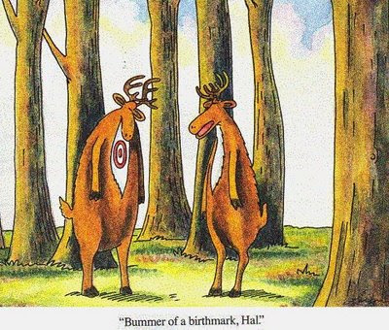
Why Distract? In order to shoot accurately, a person must be able to complete a physical process:
2. Put the front sight on target: The skill needed to hit a moving target versus a stationary target is much greater.

Slide 111
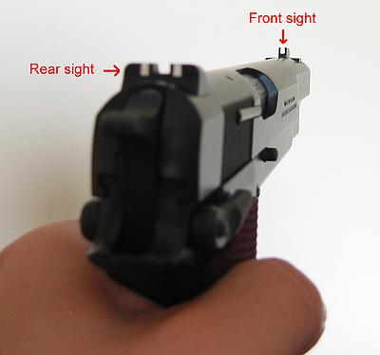
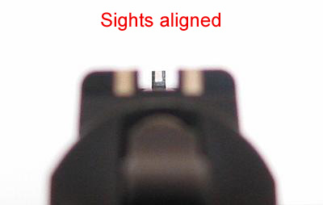
Why Distract? In order to shoot accurately, a person must be able to complete a physical process:
3. Focus on front sight: You should throw anything you can get your hands on at his head.

Slide 112
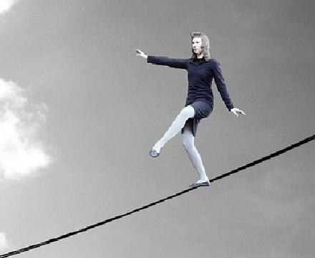
Why Distract? In order to shoot accurately, a person must be able to complete a physical process:
4. Remain steady: Throwing items at the shooter will also limit his ability to be steady.

Slide 113
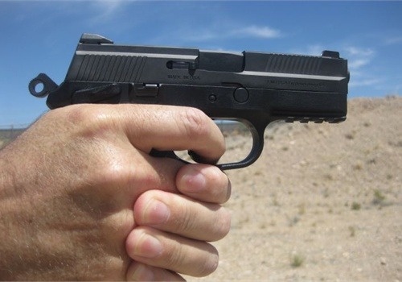
Why Distract? In order to shoot accurately, a person must be able to complete a physical process:
5. Squeeze trigger: shooter’s ability to be smooth on the trigger.

Slide 114
Why Distract? In order to shoot accurately, a person must be able to complete a physical process:
1. Find the target: Distance between shooter and target requires greater skill to hurt you.
2. Put the front sight on target: The skill needed to hit a moving target versus a stationary target is much greater.
3. Focus on front sight: You should throw anything you can get your hands on at his head.
4. Remain steady: Throwing items at the shooter will also limit his ability to be steady.
5. Squeeze trigger: shooter’s ability to be smooth on the trigger.

Slide 115
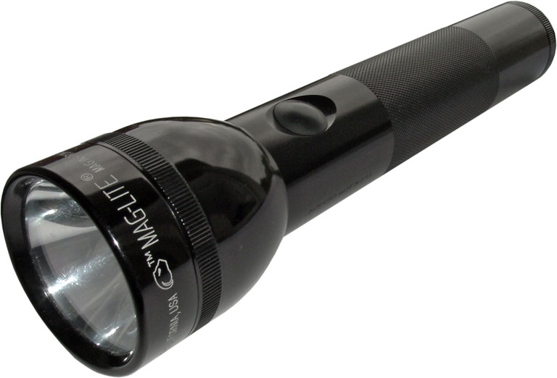

Slide 116

Counter- This is the use of simple, proactive techniques should you be confronted by the Active Shooter.

Slide 117
Counter- This is the use of simple, proactive techniques should you be confronted by the Active Shooter.
Anything can be a weapon

Slide 118
Counter- This is the use of simple, proactive techniques should you be confronted by the Active Shooter.
Anything can be a weapon
Throws things at the shooters head to disrupt their aim

Slide 119
Counter- This is the use of simple, proactive techniques should you be confronted by the Active Shooter.
Anything can be a weapon
Throws things at the shooters head to disrupt their aim
Create as much noise as possible

Slide 120
Counter- This is the use of simple, proactive techniques should you be confronted by the Active Shooter.
Anything can be a weapon
Throws things at the shooters head to disrupt their aim
Create as much noise as possible
Attack in a group (swarm)

Slide 121
Counter- This is the use of simple, proactive techniques should you be confronted by the Active Shooter.
Anything can be a weapon
Throws things at the shooters head to disrupt their aim
Create as much noise as possible
Attack in a group (swarm)
Grab the shooters limbs and head and take them to the ground and hold them there

Slide 122
Counter- This is the use of simple, proactive techniques should you be confronted by the Active Shooter.
Anything can be a weapon
Throws things at the shooters head to disrupt their aim
Create as much noise as possible
Attack in a group (swarm)
Grab the shooters limbs and head and take them to the ground and hold them there
Fight dirty-bite, kick, scratch, gouge eyes, etc.

Slide 123
Counter- This is the use of simple, proactive techniques should you be confronted by the Active Shooter.
Anything can be a weapon
Throws things at the shooters head to disrupt their aim
Create as much noise as possible
Attack in a group (swarm)
Grab the shooters limbs and head and take them to the ground and hold them there
Fight dirty-bite, kick, scratch, gouge eyes, etc.
Run around the room and create chaos

Slide 124
Counter- This is the use of simple, proactive techniques should you be confronted by the Active Shooter.
Anything can be a weapon
Throws things at the shooters head to disrupt their aim
Create as much noise as possible
Attack in a group (swarm)
Grab the shooters limbs and head and take them to the ground and hold them there
Fight dirty-bite, kick, scratch, gouge eyes, etc.
Run around the room and create chaos
If you have control of the shooter call 911 and tell the police where you are and listen to their commands when officers arrive on scene.

Slide 125
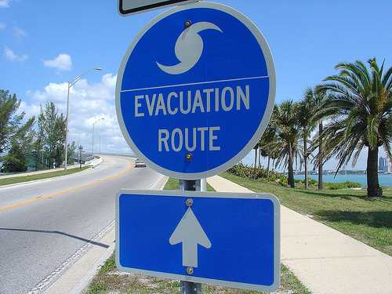
Evacuate- Remove yourself from the danger zone as quickly as possible.

Slide 126
Evacuate- Remove yourself from the danger zone as quickly as possible.
Decide if you can safely evacuate

Slide 127
Evacuate- Remove yourself from the danger zone as quickly as possible.
Decide if you can safely evacuate
Run in a zigzag pattern as fast as you can

Slide 128
Evacuate- Remove yourself from the danger zone as quickly as possible.
Decide if you can safely evacuate
Run in a zigzag pattern as fast as you can
Do not stop running until you are far away from the area

Slide 129
Evacuate- Remove yourself from the danger zone as quickly as possible.
Decide if you can safely evacuate
Run in a zigzag pattern as fast as you can
Do not stop running until you are far away from the area
Bring something to throw with you in case you would encounter the Active Shooter

Slide 130
Evacuate- Remove yourself from the danger zone as quickly as possible.
Decide if you can safely evacuate
Run in a zigzag pattern as fast as you can
Do not stop running until you are far away from the area
Bring something to throw with you in case you would encounter the Active Shooter
Consider if the fall from a window will kill you

Slide 131
Evacuate- Remove yourself from the danger zone as quickly as possible.
Decide if you can safely evacuate
Run in a zigzag pattern as fast as you can
Do not stop running until you are far away from the area
Bring something to throw with you in case you would encounter the Active Shooter
Consider if the fall from a window will kill you
Break out windows and attempt to quickly clear glass from the frame

Slide 132
Evacuate- Remove yourself from the danger zone as quickly as possible.
Decide if you can safely evacuate
Run in a zigzag pattern as fast as you can
Do not stop running until you are far away from the area
Bring something to throw with you in case you would encounter the Active Shooter
Consider if the fall from a window will kill you
Break out windows and attempt to quickly clear glass from the frame
Consider using belts, clothing or other items as an improvised rope to shorten the distance you would fall

Slide 133
Evacuate- Remove yourself from the danger zone as quickly as possible.
Decide if you can safely evacuate
Run in a zigzag pattern as fast as you can
Do not stop running until you are far away from the area
Bring something to throw with you in case you would encounter the Active Shooter
Consider if the fall from a window will kill you
Break out windows and attempt to quickly clear glass from the frame
Consider using belts, clothing or other items as an improvised rope to shorten the distance you would fall
Hang by your hands from the window ledge to shorten your drop

Slide 134
Evacuate- Remove yourself from the danger zone as quickly as possible.
Decide if you can safely evacuate
Run in a zigzag pattern as fast as you can
Do not stop running until you are far away from the area
Bring something to throw with you in case you would encounter the Active Shooter
Consider if the fall from a window will kill you
Break out windows and attempt to quickly clear glass from the frame
Consider using belts, clothing or other items as an improvised rope to shorten the distance you would fall
Hang by your hands from the window ledge to shorten your drop
Attempt to drop into shrubs, mulch or grass to lessen the chance of injury

Slide 135
Evacuate- Remove yourself from the danger zone as quickly as possible.
Decide if you can safely evacuate
Run in a zigzag pattern as fast as you can
Do not stop running until you are far away from the area
Bring something to throw with you in case you would encounter the Active Shooter
Consider if the fall from a window will kill you
Break out windows and attempt to quickly clear glass from the frame
Consider using belts, clothing or other items as an improvised rope to shorten the distance you would fall
Hang by your hands from the window ledge to shorten your drop
Attempt to drop into shrubs, mulch or grass to lessen the chance of injury
Do not attempt to drive from the area

Slide 136
Secondary Issues
Responding Police will have their weapons drawn and ready for use. They do not know exactly who the shooter is and will probably point weapons at you. Just remain calm and follow any directions they may give you. You may be asked questions, patted down, and given orders to exit certain ways.

Slide 137
Secondary Issues
Responding Police are there to stop the Active Shooter as soon as possible. They will bypass injured people and will not help you escape. Only after the shooter is stopped will they begin to provide other assistance.

Slide 138
Secondary Issues
If you come into possession of a weapon, do NOT, carry or brandish it! Police may think you are the Active Shooter. If possible, put it in a trashcan and carry it with you. If you come across Police, calmly tell them what you are carrying and why. Follow their commands.
Or, place trash can over it and have someone sit on it.

Slide 139
Secondary Issues
Be prepared to provide first aid. Think outside the box. Tampons and feminine napkins can be used to stop blood loss. Shoe laces and belts can be used to secure tourniquets. Weighted shoes can be tied around a person’s head to immobilize it. Remember it may be several hours until can safely move an injured person. The actions you take immediately to treat them may save their life.

Slide 140
Secondary Issues
If you are in lockdown for a long period of time, staff should give consideration to issues such as bathroom use, keeping people calm, etc.

Slide 141
Secondary Issues
Discuss before hand with people in your classes where you will meet up should you have to evacuate and make it a place easily accessible and far away from the scene.

Slide 142
Secondary Issues
Talk to your fellow students and teachers before hand to know if they have any special skills. Consider strategic placement of these people in a classroom or office setting. You may have current or ex-military personnel, medically trained persons, or even people trained in martial arts that can provide assistance in this type of incident.

Slide 143
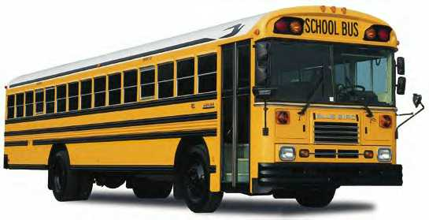

Slide 144
A.L.i.C.E
ENHANCED LOCKDOWN
‘RESPONSE OPTIONS’
Questions?

